Slide 1
Learning Objectives
Feature Importance & Selection
Benefits of Feature Selection
Feature Selection Techniques

Slide 2
Problem & Solution
Problem: Gone are the days when you had 5 variables to fit your linear regression: Modern datasets contain more variables/features to choose from. A dataset with 50 or more features -> more than 1 million observations.
Solution: Feature Importance and Selection
We will come to why/benefits very soon!

Slide 3
Feature Importance and Feature Selection
What, why and how?

Slide 4
Feature Importance and Feature Selection
Feature Importance refers to techniques that assign a score to input features based on how useful they are at predicting a target variable.
Feature Selection is the process where you automatically or manually select features which contribute most to your target variable.
In short, Feature Importance Scores are used for performing Feature Selection

Slide 5
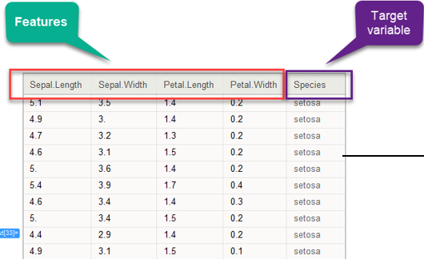
Iris Dataset

Slide 6
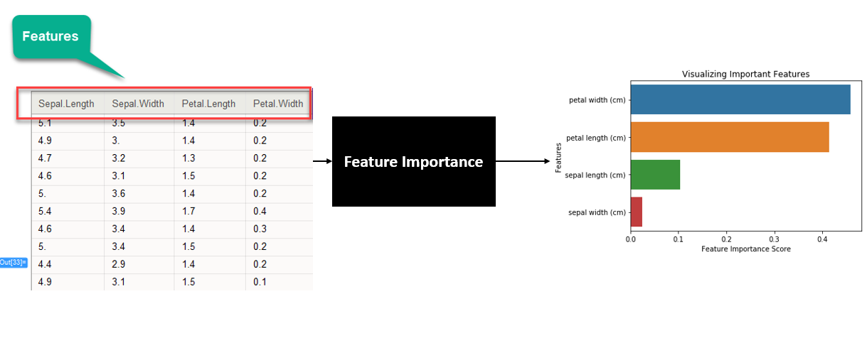
Feature Importance

Slide 7
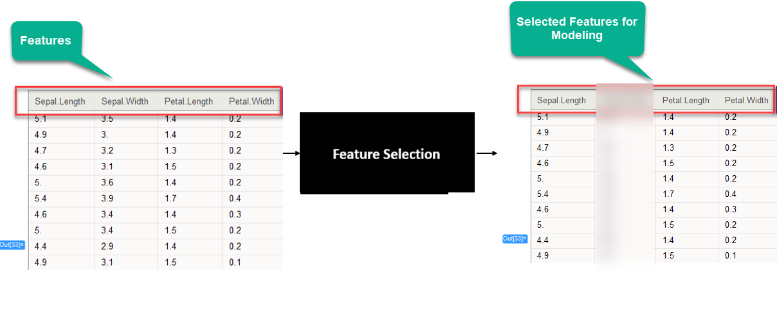
Feature Selection
Manual or auto selection

Slide 8
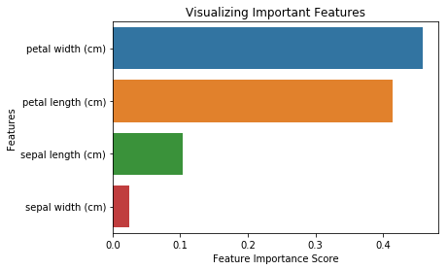
How?
Suppose we’re working on the Iris Classification. We’ll first create a baseline model using Logistic Regression. Now, we want to try out Feature Selection and try to improve our model’s performance. On plotting feature importance scores, we obtain the below graph:
Feature Importance Scores tell us that Petal width and height are the the top 2 features. The rest have a much lower importance score.
We’ll select these 2 features.
We’ll transform our existing dataset to contain only these 2 features.
We’ll train our model on this transformed dataset.
Finally, we’ll compare the evaluation metrics of our initial Logistic Regression model with this new model.

Slide 9
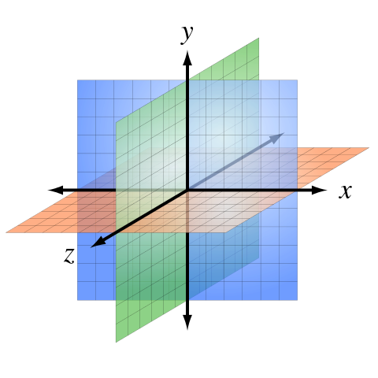
Why Feature Selection?
You already know a number of optimization methods by now and might think what’s the need of reducing our data by feature selection if we can just optimize?
There’s something known as “The curse of dimensionality”.
In machine learning,
“dimensionality” = number of features (i.e. input variables) in your dataset.
When the number of features is very large relative to
the number of observations(rows) in your dataset,
certain algorithms struggle to train effective models.
This is called the Curse of Dimensionality.

Slide 10
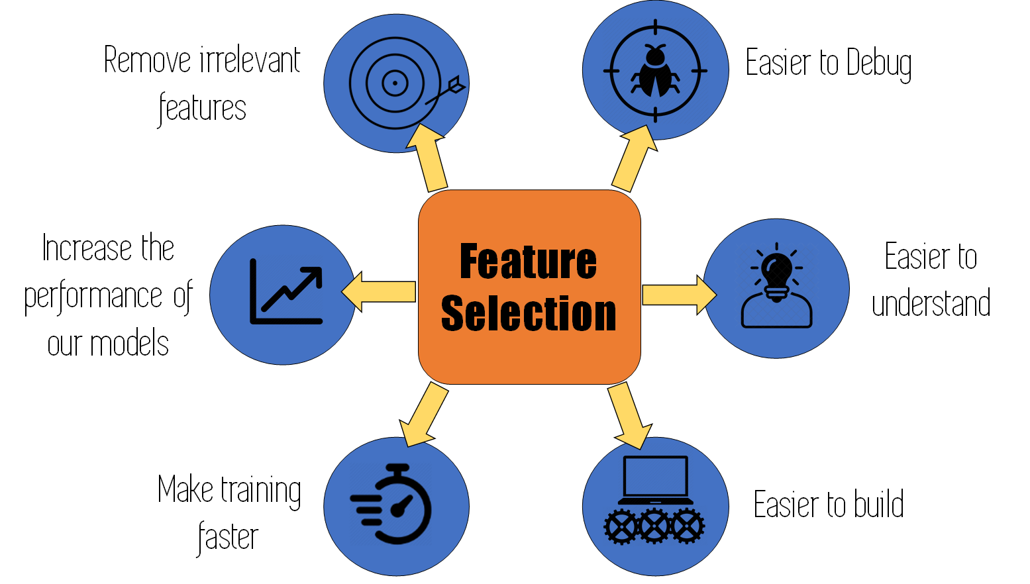
Why Feature Selection?
Image source: TowardsDataScience

Slide 11
Curse of dimensionality analogy
Let's say you have a straight line 100 yards long and you dropped a penny somewhere on it. It wouldn't be too hard to find. You walk along the line and it takes two minutes.
Now let's say you have a square 100 yards on each side and you dropped a penny somewhere on it. It would be pretty hard, like searching across two football fields stuck together. It could take days.
Now a cube 100 yards across. That's like searching a 30-story building the size of a football stadium. Ugh.
The difficulty of searching through the space gets a lot harder as you have more dimensions.

Slide 12
Benefits of performing Feature Selection
You might’ve gotten an idea of why feature selection is required by now.
Feature Selection helps us with the following:
Reduces Overfitting: Less redundant data means less opportunity to make decisions based on noise(irrelevant data).
Improves Model Performance: Less misleading data means our model’s performance improves.
Reduces Training Time: Less data means that algorithms train faster.

Slide 13
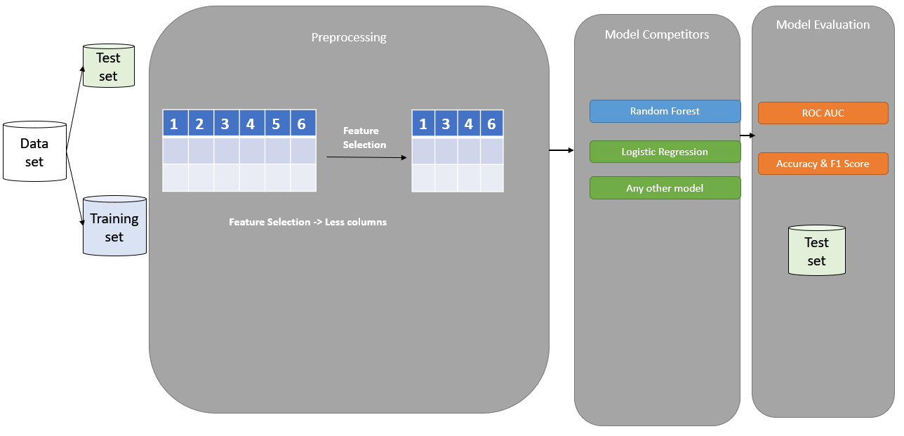
Setting up Experiments

Slide 14
Feature Selection Techniques
Try and Google ‘Feature Selection Techniques’. You’ll find that each article will talk about a different set of techniques. The number of Feature Selection Techniques are so extensive that it is not possible to demonstrate all the techniques on one dataset.
It is also important to note that not all techniques will improve the performance of the model. Sometimes, the main focus is to reduce the dimension even at the cost of some reduction in performance.
Different techniques work well on different datasets. It is best to start with a simple technique, see if it improves accuracy and work your way up by trying our more techniques while comparing the improvement in accuracy.

Slide 15
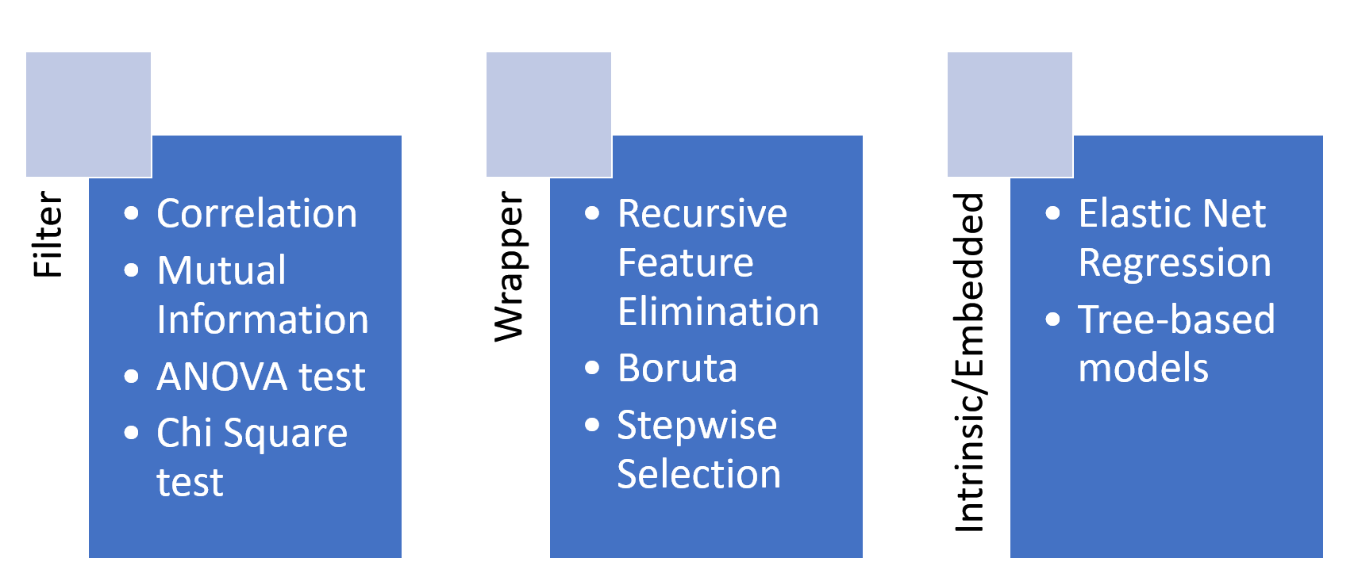
Types of Feature Selection Algorithms

Slide 16
Filter
Based on statistical methods
Image source: Analytics Vidhya

Slide 17
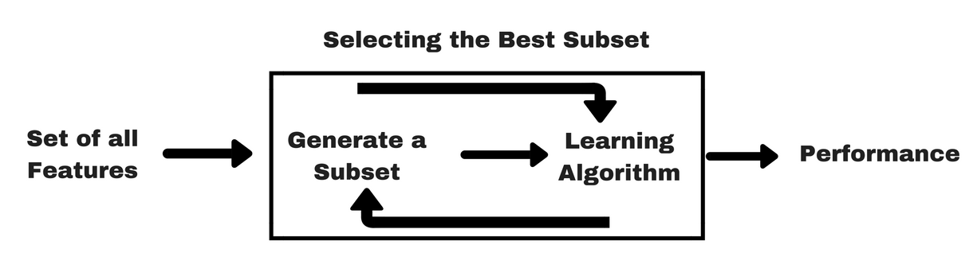
Wrapper
Image source: Analytics Vidhya

Slide 18
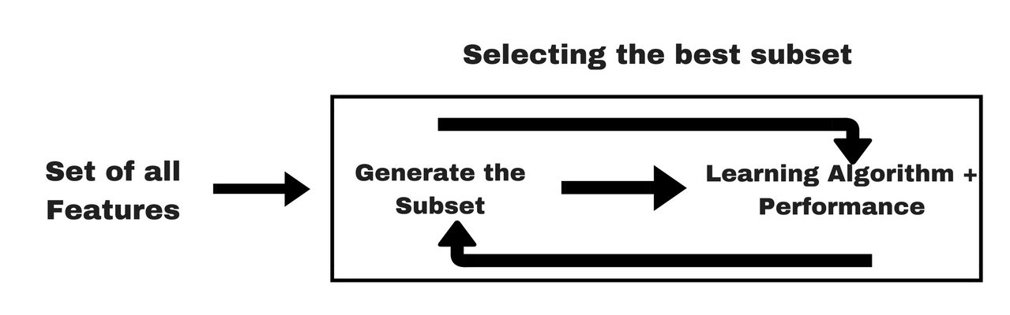
Embedded
Image source: Analytics Vidhya

Slide 19
Summary: Types of Feature Selection Algorithms
Filter Methods
Filter feature selection methods apply a statistical measure to assign a scoring to each feature. Eg: ANOVA, Chi-Square
Wrapper Methods
Wrapper methods consider the selection of a set of features as a search problem, where different combinations are prepared, evaluated and compared to other combinations. Eg: Recursive, Boruta
Embedded/Intrinsic Methods
Embedded methods learn which features best contribute to the accuracy of the model while the model is being created. The most common type of embedded feature selection methods are regularization methods. Eg: Tree Based Models, Elastic Net Regression

Slide 20
What will be covered?
We’ll implement 4 techniques in the notebook and see how much improvement occurs by comparing each to a baseline model (basic model without any modifications).
Recursive Feature Elimination (RFE)
Feature Importance using Random Forest Classifier
Boruta
XGBoost (this is a slightly advanced technique)
There are many more techniques but the above ones are popular and widely used in the industry.
Refer the below notebook in next slide to learn more about the techniques!

Slide 21
Feature Selection Notebook
Notebook link:
https://dphi.tech/notebooks/896/manish_kc_06/feature_selection_techniques?

Slide 22
Boruta
Boruta follows an all-relevant feature selection method where it captures all features which are in some way or other relevant to the target variable.
In contrast, most of the traditional feature selection algorithms follow a minimal optimal method where they rely on a small subset of features which yields a minimal error on a chosen classifier.

Slide 23
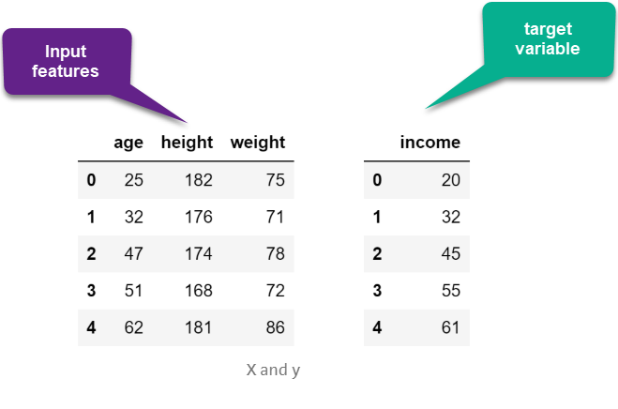
Dataset

Slide 24
How does Boruta work?
Shadow features: Firstly, it adds randomness to the given data set by creating shuffled copies of all features (which are called shadow features). In other words, Boruta duplicates the dataset, and shuffle the values in each column. These values are called shadow features. Look at the examples in next slide
Then, it trains a random forest classifier on the new data set and applies a feature importance measure to evaluate the importance of each feature where higher means more important.
There is some magical statistical score called z-score (gives you an idea of how far from the mean a data point is). At every iteration, the algorithm (Boruta) compares the Z-scores of shadow features and the original features to see if original features are performing better than shadow features or not. If it does, the algorithm will mark the feature as important.
Finally, the algorithm stops either when all features get confirmed or rejected or it reaches a specified limit of random forest runs.

Slide 25
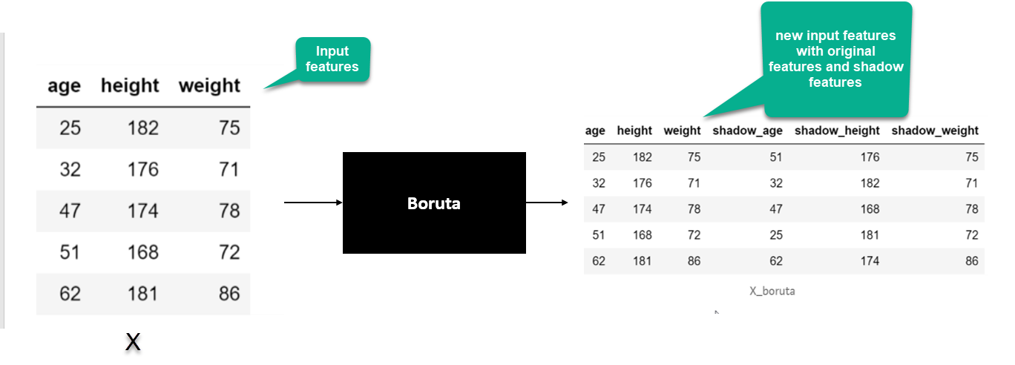
Boruta Intuition

Slide 26
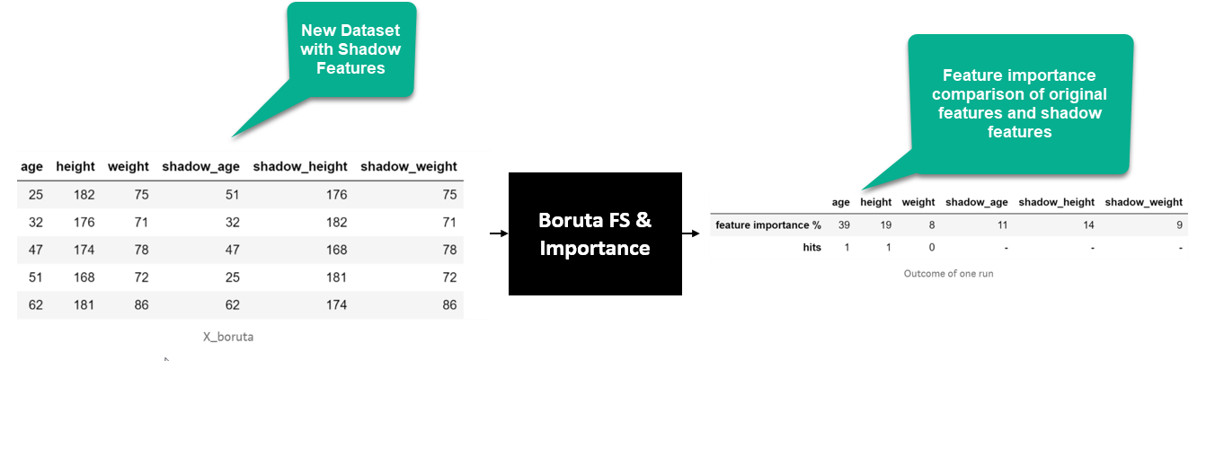
Boruta Intuition
Boruta + Random forest classifier

Slide 27
What makes it different?
In essence, Boruta is trying to validate the importance of the feature by comparing with random shuffled copies (shadow features), which increases the robustness. This is done by simply comparing the number of times a feature did better with the shadow features using a z-score.
Comparison with standard random forest algorithm: While fitting a random forest model on a data set, you can recursively get rid of features in each iteration which didn’t perform well in the process. This will eventually lead to a minimal optimal subset of features as the method minimizes the error of random forest model. This happens by selecting an over-pruned version of the input data set, which in turn, throws away some relevant features. On the other hand, boruta find all features which are either strongly or weakly relevant to the decision variable. So this makes it very unique

Slide 28
Boruta References
The following article explains it intuitively and it was implemented from scratch: https://towardsdatascience.com/boruta-explained-the-way-i-wish-someone-explained-it-to-me-4489d70e154a
The below article is in R programming - but still it gives a nice comprehensive view about Boruta with a dataset: https://www.datacamp.com/community/tutorials/feature-selection-R-boruta
https://www.analyticsvidhya.com/blog/2016/03/select-important-variables-boruta-package/

Slide 29
Slide Download Link
You can download the slides here:
https://docs.google.com/presentation/d/1WSic5OQxwPU3nXuAxeX7RJEyFEuFiH5bmJX8nsviv0Q/edit?usp=sharing

Slide 30
That’s it for this unit. Thank you!
Feel free to post any queries on Discuss.

